Slide 1

Examples Summary
For Communications , SCE 3rd year.

Slide 2
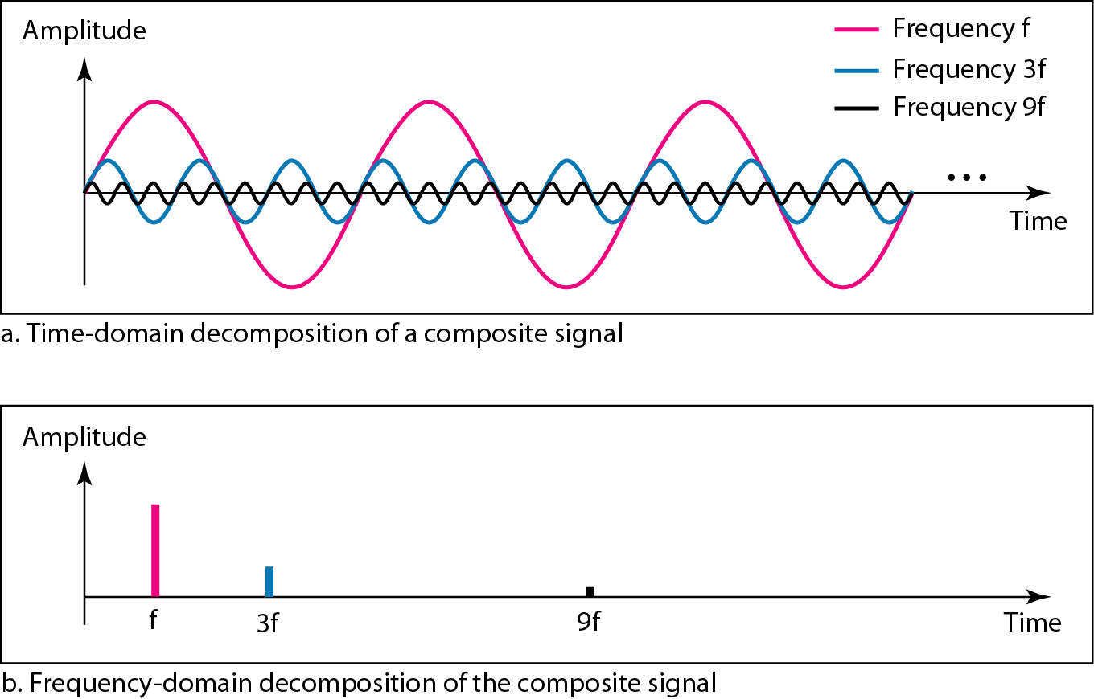
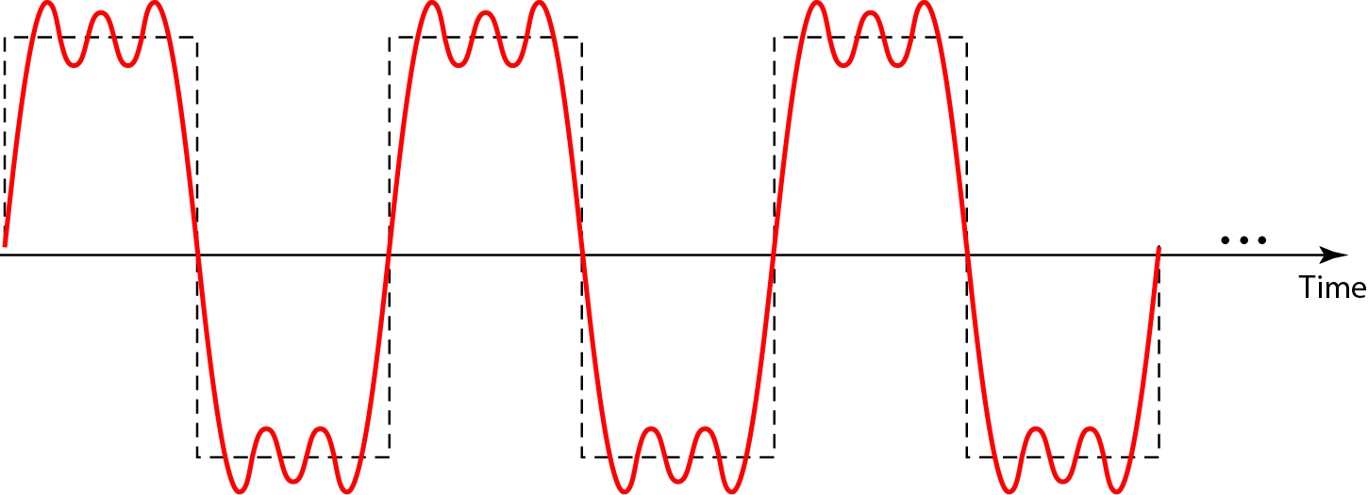
Example 1
Figure shows a periodic composite signal with frequency f. This type of signal is not typical of those found in data communications. We can consider it to be three alarm systems, each with a different frequency. The analysis of this signal can give us a good understanding of how to decompose signals.

Slide 3
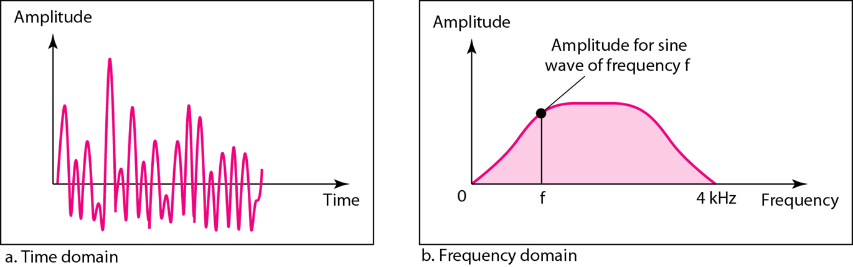
Example 2
Figure shows a nonperiodic composite signal. It can be the signal created by a microphone or a telephone set when a word or two is pronounced. In this case, the composite signal cannot be periodic, because that implies that we are repeating the same word or words with the same tone.

Slide 4
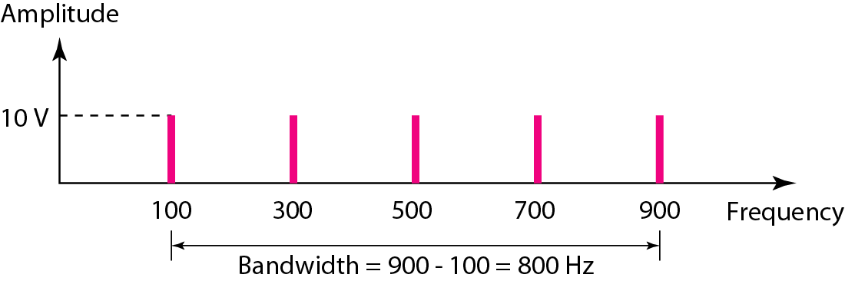
Example 3
If a periodic signal is decomposed into five sine waves with frequencies of 100, 300, 500, 700, and 900 Hz, what is its bandwidth? Draw the spectrum, assuming all components have a maximum amplitude of 10 V.
Solution
Let f_{h} be the highest frequency, f_{l} the lowest frequency, and B the bandwidth.
The spectrum has only five spikes, at 100, 300, 500, 700, and 900 Hz.

Slide 5
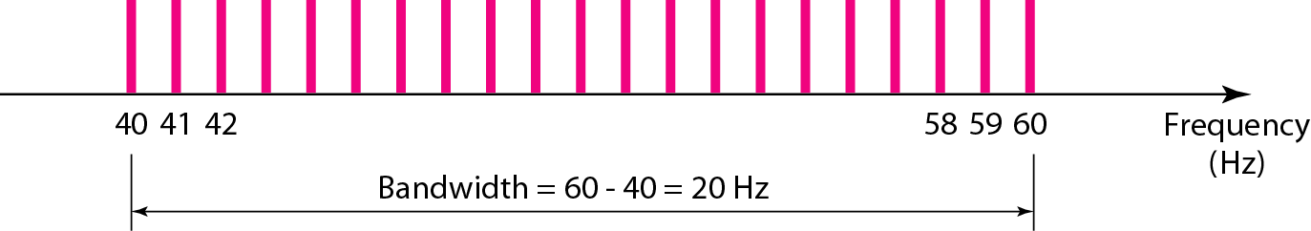
Example 4
A periodic signal has a bandwidth of 20 Hz. The highest frequency is 60 Hz. What is the lowest frequency? Draw the spectrum if the signal contains all frequencies of the same amplitude.
Solution
Let f_{h} be the highest frequency, f_{l} the lowest frequency, and B the bandwidth.
The spectrum contains all integer frequencies. We show this by a series of spikes

Slide 6
Example 5
A digital signal has eight levels. How many bits are needed per level?
Solution
We calculate the number of bits from the formula
Each signal level is represented by 3 bits.

Slide 7
Example 6
Assume we need to download text documents at the rate of 100 pages per second. What is the required bit rate of the channel?
Solution
A page is an average of 24 lines with 80 characters in each line. If we assume that one character requires 8 bits, the bit rate is

Slide 8
Example 7
A digitized voice channel, is made by digitizing a 4-kHz bandwidth analog voice signal. We need to sample the signal at twice the highest frequency (two samples per hertz). We assume that each sample requires 8 bits. What is the required bit rate?
Solution
The bit rate can be calculated as

Slide 9
Example 8
What is the bit rate for high-definition TV (HDTV)? Solution
HDTV uses digital signals to broadcast high quality video signals. The HDTV screen is normally a ratio of 16 : 9. There are 1920 by 1080 pixels per screen, and the screen is renewed 30 times per second. Twenty-four bits represents one color pixel.
The TV stations reduce this rate from 20 to 40 Mbps through compression.

Slide 10

Example 9
Suppose a signal travels through a transmission medium and its power is reduced to one-half. This means that P2 is (1/2)P1. In this case, the attenuation (loss of power) can be calculated as
A loss of 3 dB (–3 dB) is equivalent to losing one-half the power.

Slide 11

Example 10
A signal travels through an amplifier, and its power is increased 10 times. This means that P₂ = 10P₁ . In this case, the amplification (gain of power) can be calculated as

Slide 12

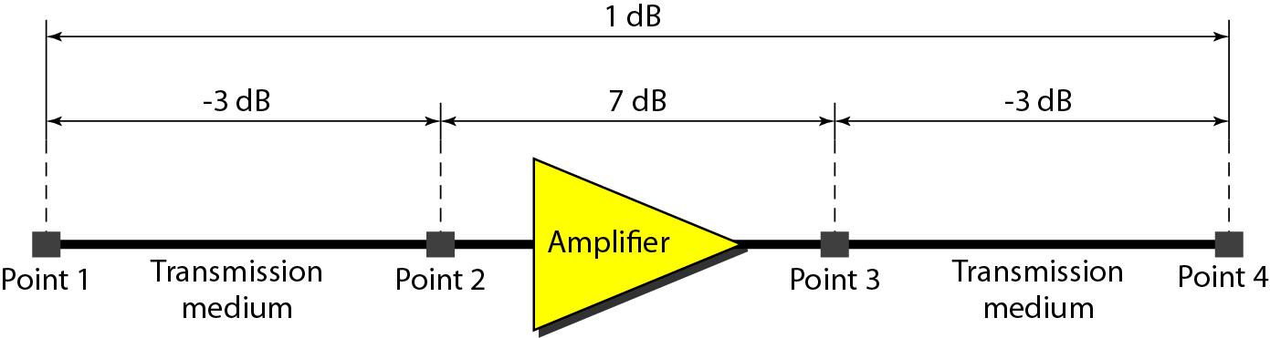
Example 11
One reason that engineers use the decibel to measure the changes in the strength of a signal is that decibel numbers can be added (or subtracted) when we are measuring several points (cascading) instead of just two. a signal travels from point 1 to point 4. In this case, the decibel value can be calculated as

Slide 13
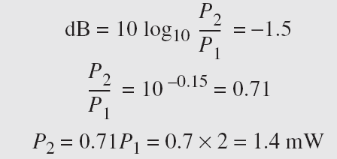
Example 12
The loss in a cable is usually defined in decibels per kilometer (dB/km). If the signal at the beginning of a cable with −0.3 dB/km has a power of 2 mW, what is the power of the signal at 5 km?
Solution
The loss in the cable in decibels is 5 × (−0.3) = −1.5 dB.
We can calculate the power as

Slide 14
Example 13
The power of a signal is 10 mW and the power of the noise is 1 μW; what are the values of SNR and SNR_{dB} ?
Solution
The values of SNR and SNRdB can be calculated as follows:

Slide 15
Example 14
Consider a noiseless channel with a bandwidth of 3000 Hz transmitting a signal with two signal levels. The maximum bit rate can be calculated as
Bit Rate = Capacity in Bit per Second.

Slide 16
Example 15
We need to send 265 kbps over a noiseless channel with a bandwidth of 20 kHz. How many signal levels do we need?
Solution
We can use the Nyquist formula :
Since this result is not a power of 2, we need to either increase the number of levels or reduce the bit rate. If we have 128 levels, the bit rate is 280 kbps. If we have 64 levels, the bit rate is 240 kbps.

Slide 17
Example 16
Consider an extremely noisy channel in which the value of the signal-to-noise ratio is almost zero. In other words, the noise is so strong that the signal is faint. For this channel, the capacity C is calculated as
This means that the capacity of this channel is zero regardless of the bandwidth. In other words, we cannot receive any data through this channel.

Slide 18
Example 19
We can calculate the theoretical highest bit rate of a regular telephone line. A telephone line normally has a bandwidth of 3000. The signal-to-noise ratio is usually 3162. For this channel, the capacity is calculated as
This means that the highest bit rate for a telephone line is 34.860 kbps. If we want to send data faster than this, we can either increase the bandwidth of the line or improve the signal-to-noise ratio.

Slide 19


Example 18
The signal-to-noise ratio is often given in decibels.
Assume that SNR_{dB} = 36 and the channel bandwidth is 2 MHz.
The theoretical channel capacity can be calculated as
when the SNR is very high, we can assume that SNR + 1 is almost the same as SNR. In these cases, the theoretical channel capacity can be simplified to

Slide 20
Example 19
We have a channel with a 1-MHz bandwidth. The SNR for this channel is 63. What are the appropriate bit rate and signal level?
Solution
First, we use the Shannon formula to find the upper limit.
The Shannon formula gives us 6 Mbps, the upper limit. For better performance we choose something lower, 4 Mbps, for example. Then we use the Nyquist formula to find the number of signal levels.

Slide 21
Example 20
Check The data : 1100111 1011101 0111001 0101001 BY Two-dimensional Parity check
1 | 0 | 1 | 0 | 1 | 0 | 0 | 1
0 | 0 | 1 | 1 | 1 | 0 | 0 | 1
1 | 1 | 0 | 1 | 1 | 1 | 0 | 1
1 | 1 | 1 | 0 | 0 | 1 | 1 | 1
1 | 0 | 1 | 0 | 1 | 0 | 1 | 0
1 | 0 | 1 | 0 | 1 | 0 | 0 | 1 | 0
0 | 0 | 1 | 1 | 1 | 0 | 0 | 1 | 0
1 | 1 | 0 | 1 | 1 | 1 | 0 | 1 | 0
1 | 1 | 1 | 0 | 0 | 1 | 1 | 1 | 0
1 | 0 | 1 | 0 | 1 | 0 | 1 | 0 | 0
0 | 0 | 0 | 0 | 0 | 0 | 0 | 0 | 0
Sent
Received

Slide 22
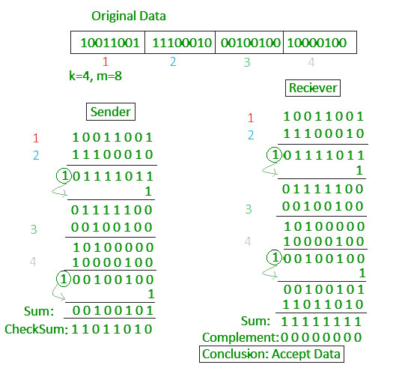
Example 21
Check Sum the following data :
10011001 11100010 00100100 10000100

Slide 23
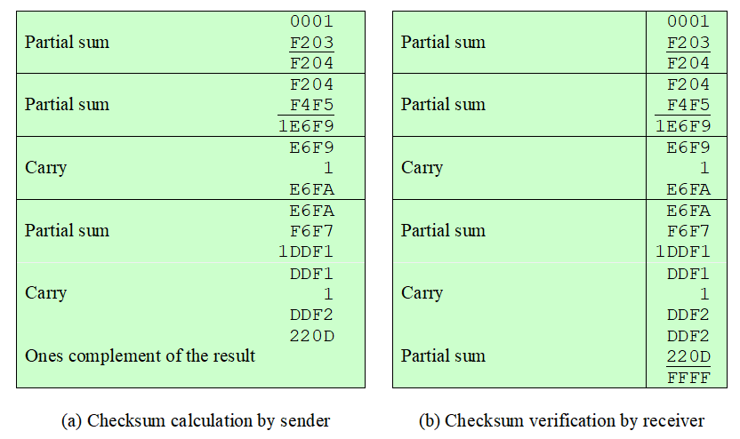
Example 22
Consider a header that consists of 10 octets, with the checksum in the last two octets with the following content (in hexadecimal):
00 01 F2 03 F4 F5 F6 F7 00 00
Note that the checksum field is set to zero.
Figure a shows the results of the calculation. Thus, the transmitted packet is 00 01 F2 03 F4 F5 F6 F7 0D.
Figure b shows the calculation carried out by the receiver on the entire data block, including the checksum. The result is a value of all ones, which verifies that no errors have been detected.

Slide 24
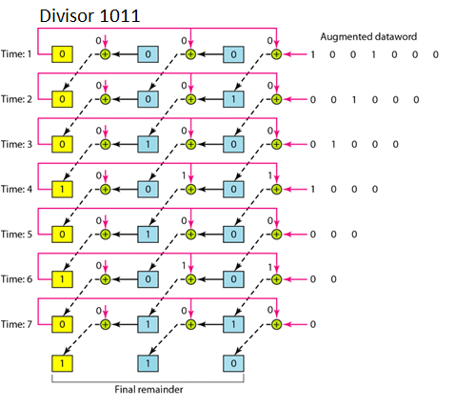
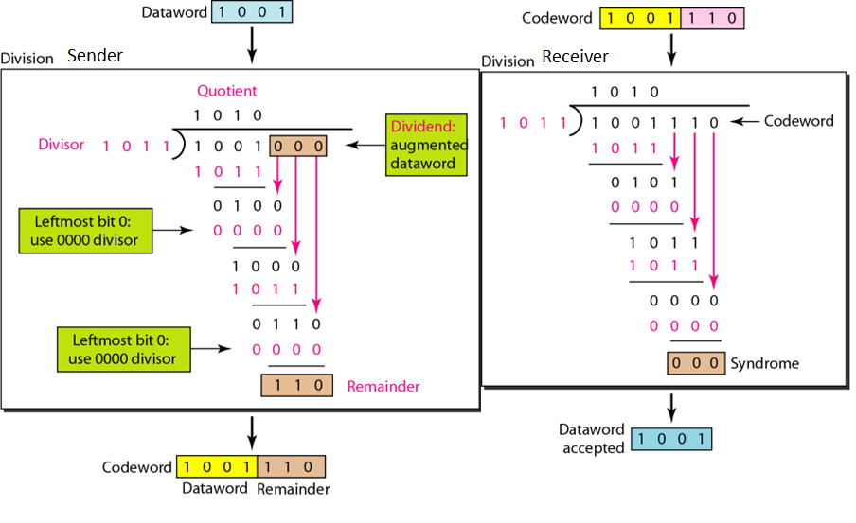
Example 23
The Data Word is 1001 , Divisor is 1011 use CRC method to check.
Note the 0 cuts the opposite line in the Hardware.

Slide 25
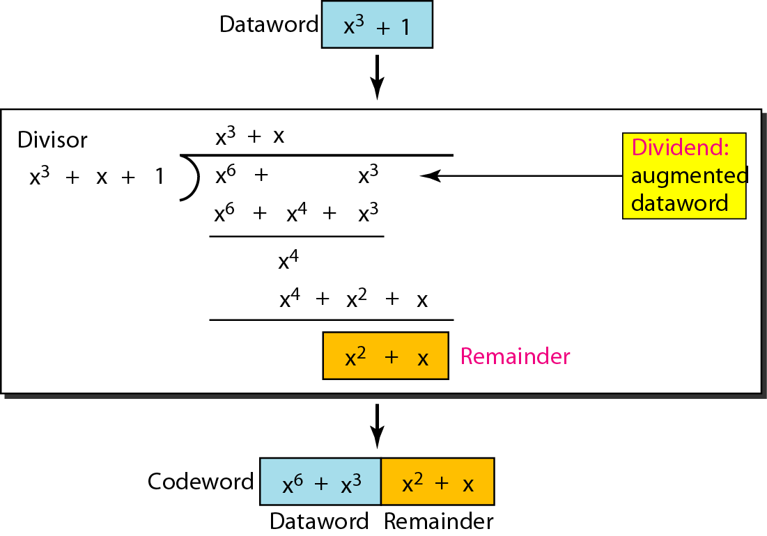

Example 24
CRC division using polynomials :
the data word : $x^{3}+1$ and Divisor : $x^{3}+x+1$
Stop when the result order less than Divisor order.

Slide 26
Example 25
Example: Data value is 10011010
12-bit pattern is P1 P2 1 P4 0 0 1 P8 1 0 1 0
P1 checks bits 1,3,5,7,9, 11, i.e., _ _1_ 0 0 1_1 0 1 0. Set bit P1 to 0.
P2 checks bits 2,3,6,7,10,11, i.e., 0_ 1_ 0 0 1_ 1 0 1 0. Set P2 to 1.
P4 checks bits 4,5,6,7,12, i.e., 0 1 1_ 0 0 1_ 1 0 1 0. Set P4 to 1.
P8 checks bits 8,9,10,11,12, i.e., 0 1 1 1 0 0 1_ 1 0 1 0. Set P8 to 0.
_ _ 1_ 0 0 1_ 1 0 1 0 → Hamming code: 011100101010
Inverting bit 10 changes it to 011100101110.
Parity bit 1 is 0 (011100101110 has four 1’s, this group is OK).
Parity bit 2 is 1 (011100101110 has five 1’s, an error somewhere).
Parity bit 4 is 1 (011100101110 has two 1’s, this group is OK).
Parity bit 8 is 1 (011100101110 has three 1’s, an error somewhere).
Parity bits 2 and 8 are incorrect. As 2 +8 =10, bit 10 must be wrong.
Hence, we can correct the error by inverting bit 10: 011100101010

Slide 27
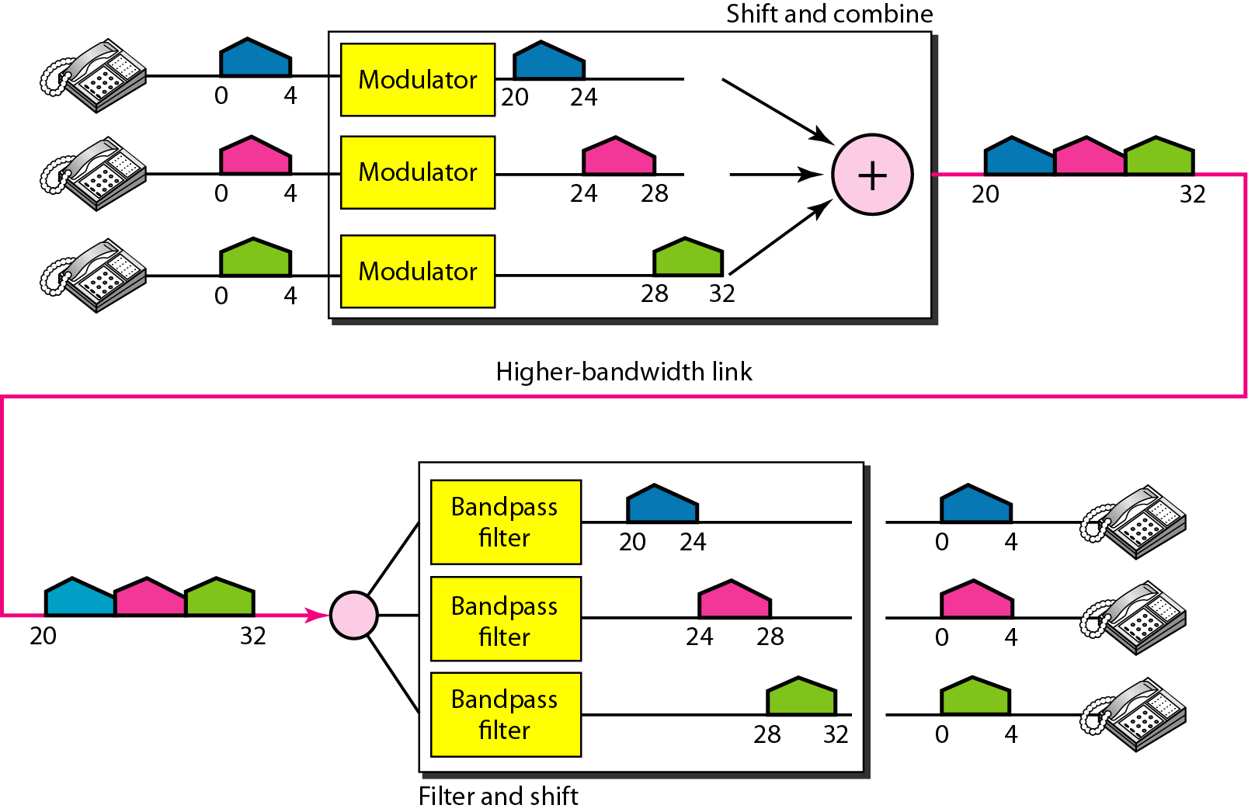
Example 26
Assume that a voice channel occupies a bandwidth of 4 kHz. We need to combine three voice channels into a link with a bandwidth of 12 kHz, from 20 to 32 kHz. Show the configuration, using the frequency domain. Assume there are no guard bands.
Solution
We shift (modulate) each of the three voice channels to a different bandwidth. We use the 20- to 24-kHz bandwidth for the first channel, the 24- to 28-kHz bandwidth for the second channel, and the 28- to 32-kHz bandwidth for the third one.

Slide 28
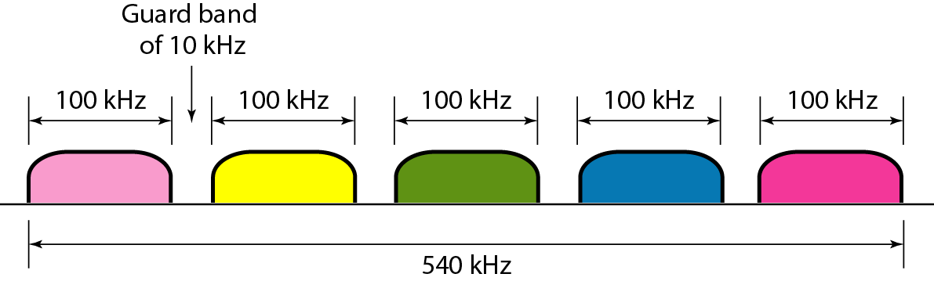
Example 27
Five channels, each with a 100-kHz bandwidth, are to be multiplexed together. What is the minimum bandwidth of the link if there is a need for a guard band of 10 kHz between the channels to prevent interference?
Solution
5 × 100 + 4 × 10 = 540 kHz,

Slide 29
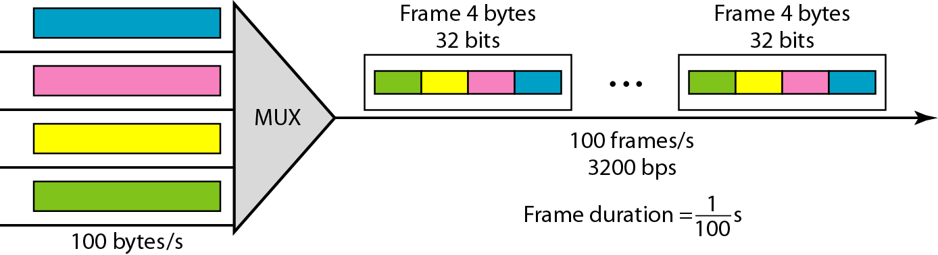
Example 28
Four channels are multiplexed using TDM. If each channel sends 100 bytes /s and we multiplex 1 byte per channel, show:
The frame traveling on the link.
The size of the frame.
The duration of a frame, the frame rate.
The bit rate for the link.
Solution
Each frame carries 1 byte from each channel;
The size of each frame, therefore, is 4 bytes, or 32 bits.
Because each channel is sending 100 bytes/s and a frame carries 1 byte from each channel, the frame rate must be 100 frames per second.
Frame duration=1/ frame rate
The bit rate is 100 × 32, or 3200 bps.

Slide 30
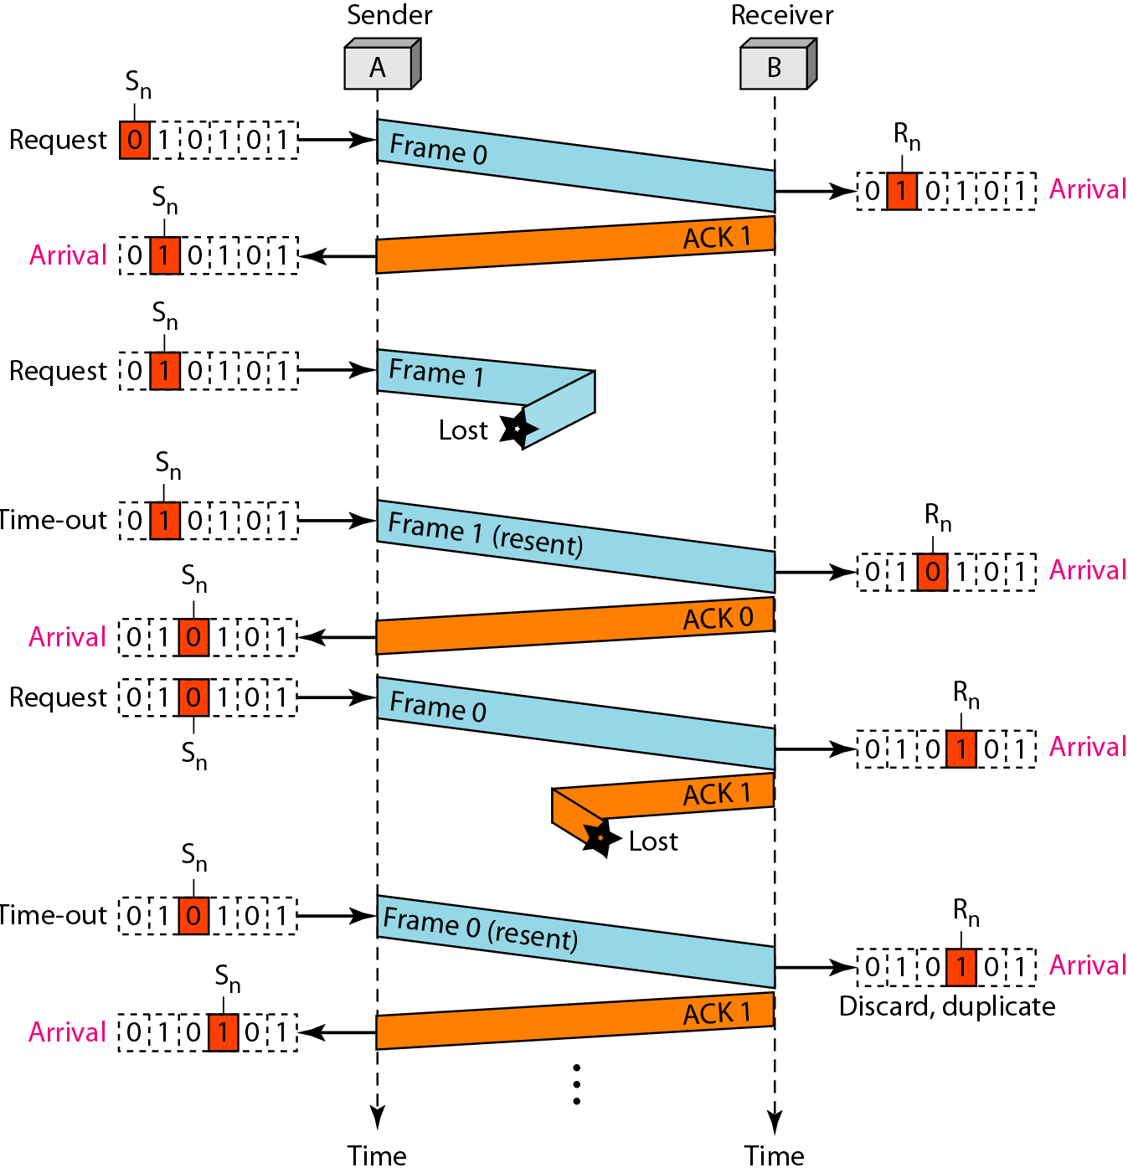
Example 29
Frame 0 is sent and acknowledged. Frame 1 is lost and resent after the time-out. The resent frame 1 is acknowledged and the timer stops. Frame 0 is sent and acknowledged, but the acknowledgment is lost. The sender has no idea if the frame or the acknowledgment is lost, so after the time-out, it resends frame 0, which is acknowledged.
Error correction in Stop-and-Wait ARQ is done by keeping a copy of the sent frame and retransmitting of the frame when the timer expires.

